Slide 1

Supply Chain
Data Analysis
Insights and Impacts
Leveraging SQL and Power BI for Deeper Understanding

Slide 2
Supply Chain Data Analysis
Introduction
I'll take you on a thorough tour of my most recent supply chain analysis in my presentation today, which will be emphasized by the sophisticated use of SQL queries and Power BI reports. The core of my study is my dataset, which includes a broad range of supply chain characteristics, such as customer demographics and specific order and shipment data.
My data was too complex and too big to handle without the use of SQL, a potent tool for data processing and querying. I was able to clean, filter, and aggregate my dataset using well constructed SQL queries, preparing it for further investigation. These searches not only reduced the size of my dataset but also produced early findings that were essential for the later phases of my investigation.
I used Power BI to enhance this refined dataset and make my data more visually appealing. Thanks to Power BI's dynamic dashboards and interactive visualizations, which also helped me to identify patterns and trends that were not immediately obvious. Power BI's strong analytical skills were helpful in determining financial potential for greater profitability as well as how efficiently supply chain operations operated.
Supply Chain Data Analysis

Slide 3
Supply Chain Data Analysis Overview
02
Products related
features
04
Order related
features
delivery status, late divery risk, order customer id, order id , order item cardpord id, order item discount rate, order item id, order item profit ratio,order status
category id, category name, product card id, product category id, product image, product name, department name
01
Date related features
03
Customer related
features
05
Amount related
features
days for shipment(scheduled) ,days for shipping (real), order date, shipping date, order year, shipping year, order month, shipping month
customer name(full, first, last), customer segment, customer_zipcode , customer id
Amount, Cost Price, discount, payment type, product selling price, profit per order, total selling price
06
Geographical
Features
customer country, latitude, longitude, market, order region, order city, order country

Slide 4
Supply Chain Data Analysis
SQL in Action: Uncovering Initial Insights
The use of statistical measures, such as avg ,sums, and counts, was made easier using SQL queries. For a KPI data like average delivery times, total sales, average discount rate, this was essential.
Sanitizing the dataset by changing the datatype from text to datetime for elements like the order and shipment dates. Or by eliminating annoying features from the dataset
2nd
Data Exploration and Filtering
4th
Joining and Merging Data
to filter data, use conditional filtering and concentrate on particular categories, time periods, or supply chain analysis relevant performance measures
Since I don’t have an additional table. Thus, I employ the dataset’s numerical features to generate a single table that I import from Power Bi
1st
Data Cleansing and Preparation
3rd
Aggregation and Summarization

Slide 5
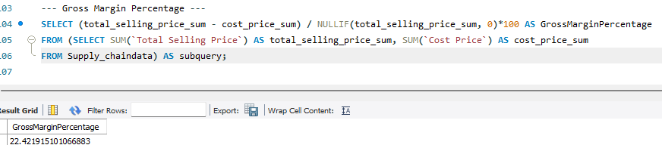
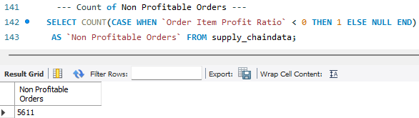
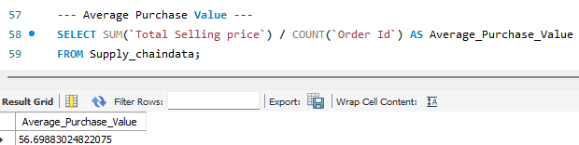
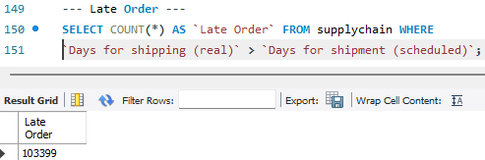
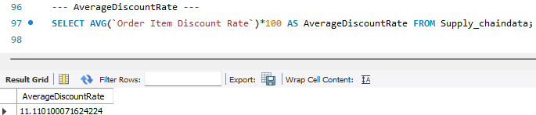
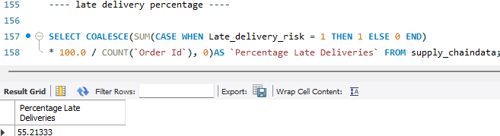
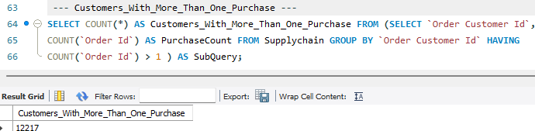
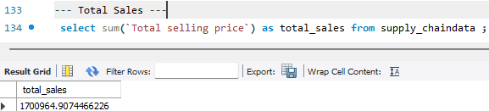
Supply Chain Data Analysis
SQL KPIs
Gross Margin %
01
Count of non Profitable Orders
Avg Purchase value
02
Count of Late Order
Avg Discount %
Late Deliveries %
Customer Purchase > 1
Total Sales

Slide 6
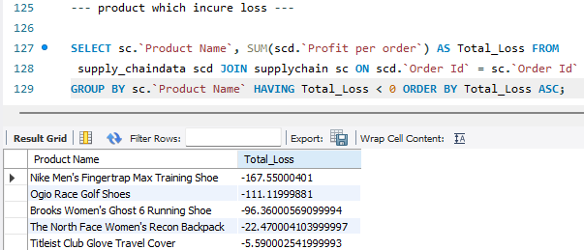
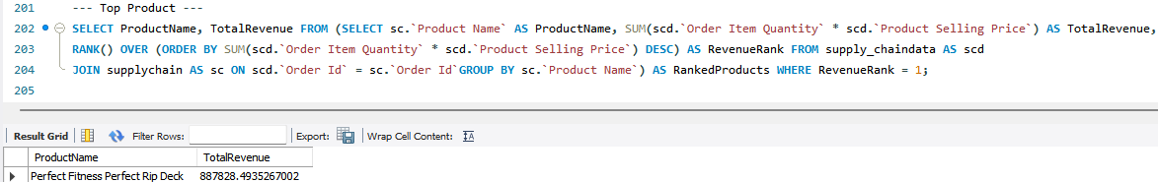
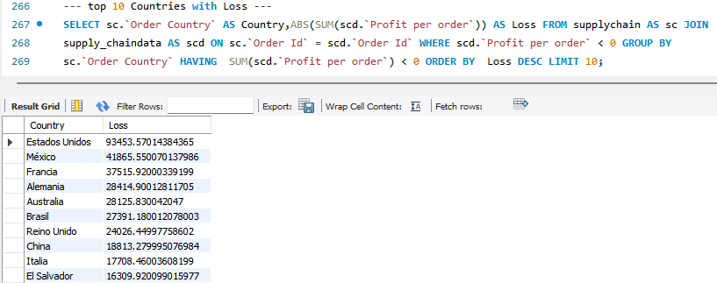
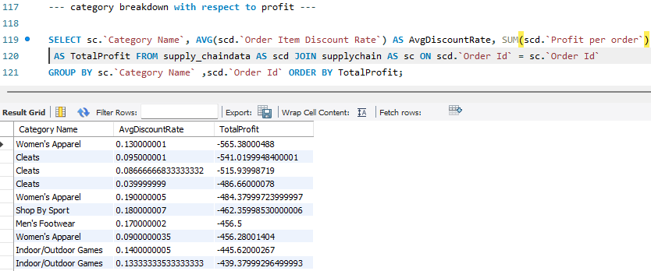
Supply Chain Data Analysis
Highly sold Product
SQL Insights
List of Product which have loss value
01
02
Product Category Breakdown by Profit
List of customers with highest revenue generation

Slide 7
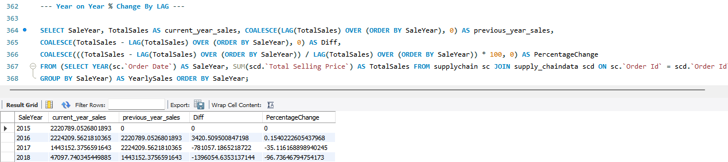
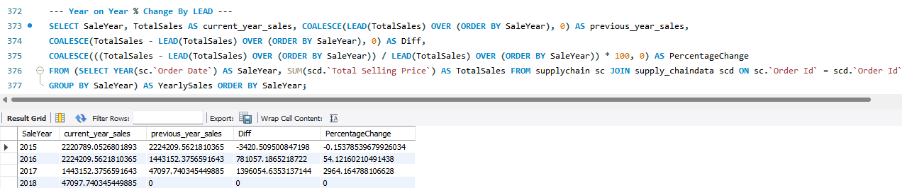
Supply Chain Data Analysis
SQL Percentage change
Year on Year % Change by LAG
01
02
Year on Year % Change by LEAD

Slide 8
Supply Chain Data Analysis
Power Bi Visualization
Right type of Visualization
Use Filters and Slicers and design for interactive reports
The type of visualization selected should complement the data’s nature.
Leverage filters, slicers in power bi to allow users to explore the datain a self service manner. Design with accessibility in mind.
Understanding Data
Leverage Power Bi Features for data modeling
Before start creating visuals, it’s essential to thoroughly understand the data at your disposal.
Use DAX to create calculated columns and measures for more dynamic and complex analyses

Slide 9
Supply Chain Dashboard overview
Home
Sales and Profit Analysis
Customer
Analysis
Order Analysis
Analytics
Innovation
Product Performance
Market and Regional Insights
Payment, Discount, Time Analysis
Temporal Analysis
Strategize
Integration

Slide 10
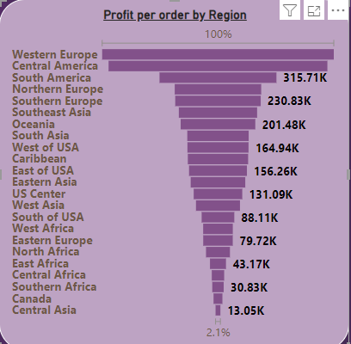
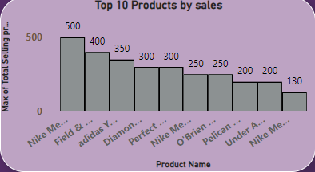
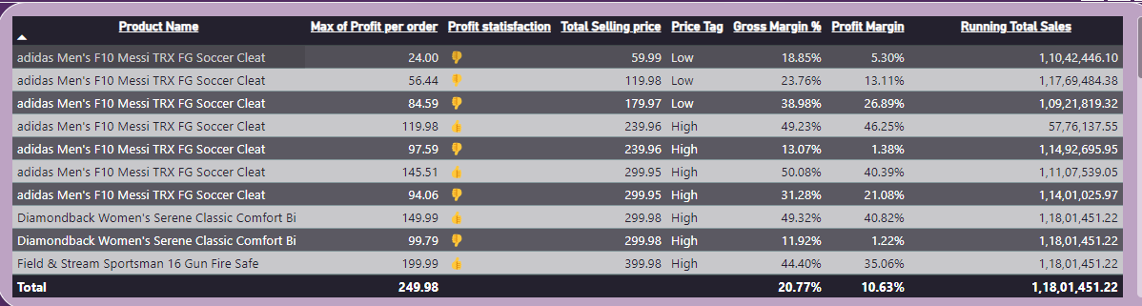
Supply Chain Data Analysis
Sales and Profit Data Analysis
Bar chart represent the most sold Products:
Nike Men's Free 5.0+ Running Shoe
Field & Stream Sportsman 16 Gun Fire Safe
adidas Youth Germany Black/Red Away Match Soc
Funnel chart represent the most Profitable Region:
Western Europe
Central America
South America
Table showing Product name with respect to their maximum Profit and selling price, price tag, Gross Margin %, Profit Margin % and Running total sales.

Slide 11
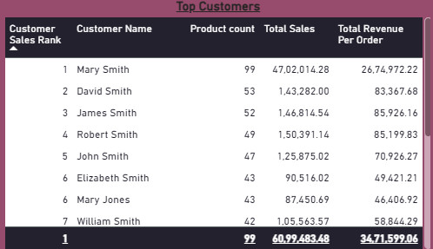
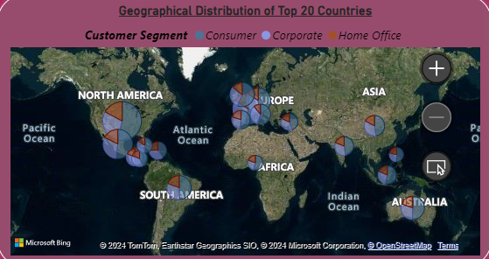
Supply Chain Data Analysis
Customer Analysis
Table showing Top Customer based on their rank of total product purchase and with total sales and Total Revenue Per Order.
Geographical Distribution of Top 20 Countries legends represent Customer Segment and bubble size represent the sum of profit per order.

Slide 12
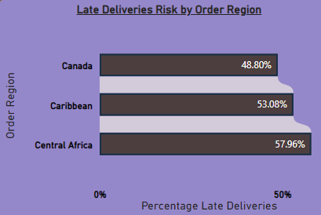
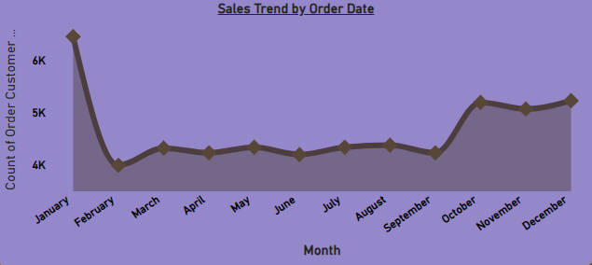
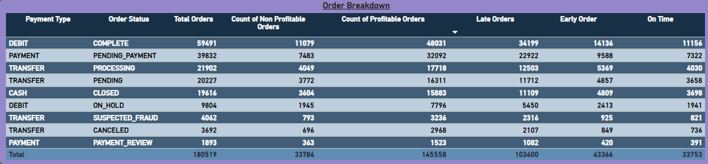
Supply Chain Data Analysis
Order Data Analysis
Late Deliveries analysis by different Region with this analysis I got to know that Canada has low risk of late deliveries as compare to other regions.
Area chart showing sales trend on different date , year, month while we drilldown.
In 2015 best selling month was January and worst was February.
Table show Breakdown on Orders features with respect to there status, profit(profitable and non profitable),late, early, on time orders.

Slide 13
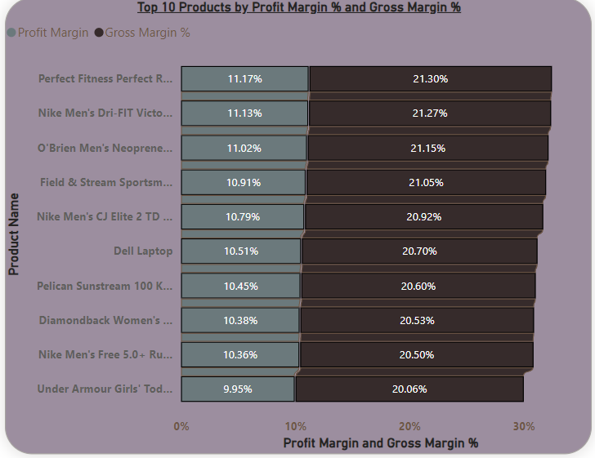
Supply Chain Data Analysis
Product Performance
Gross Margin
Gross margin percentage is a financial metric that shows the proportion of revenue that exceeds the cost of goods sold (COGS).
Gross Margin % = DIVIDE(SUM('Supply chain'[Total Selling Price]) - SUM('Supply chain'[Cost Price]),SUM('Supply chain'[Total Selling Price]),0)
This visualization represent the top 10 product having highest profit and gross margin %.
Profit Margin
Profit margin percentage, indicates the proportion of revenue that remains as profit after all expenses, including COGS, operating expenses, taxes, and interest, have been deducted.
Profit Margin % = DIVIDE([Total Profit], [Total Sales], 0)

Slide 14
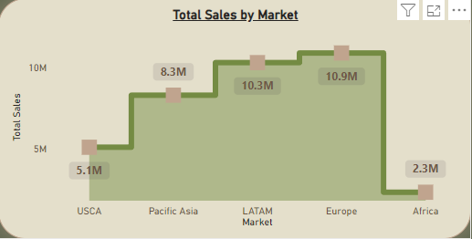
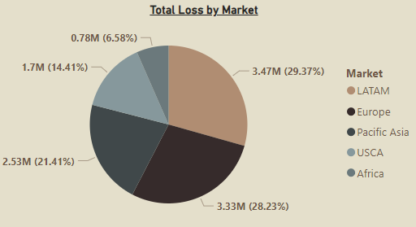
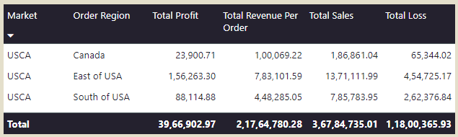
Supply Chain Data Analysis
Market and Regional Insights
Area chart representing total sales by different market as its clearly shown Europe has large market share as compare to other market.
Pie chart shows the distribution of Total loss by respected market. LATAM market is highest loss contributor to supply chain
Table show Breakdown of market and order region with their respective profit , revenue, loss contribution to the supply chain

Slide 15
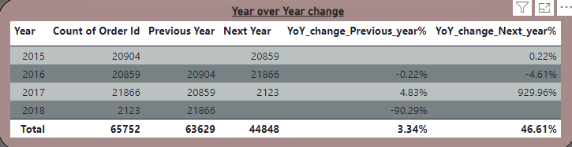
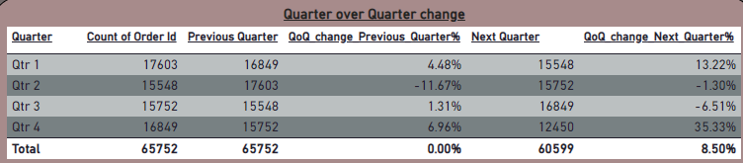
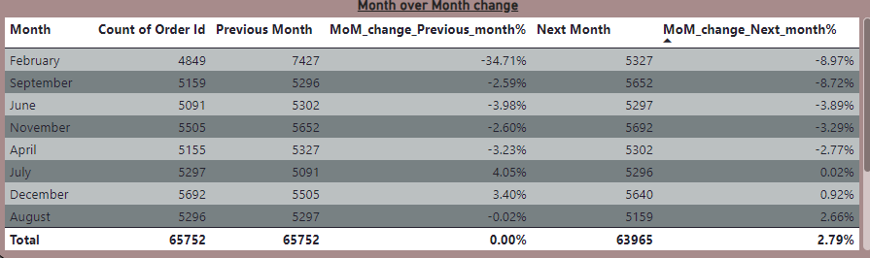
Supply Chain Data Analysis
Temporal Analysis
Table representing Percentage change of Year over Year with respect to previous and next year.
Table representing Percentage change of Quarter over Quarter with respect to previous and next Quarter.
Table representing Percentage change of Month over Month with respect to previous and next month.

Slide 16
Supply Chain Data Analysis
Supply Chain Conclusion
Conclusion
Using SQL and Power BI, I have explored the supply chain and converted data into decisions and insights into action. My transformation from raw data to strategic insights demonstrates the value of fusing in-depth supply chain expertise with cutting-edge analytics. In addition to increasing my operational efficiency, I've also paved the way for future developments, making sure that the supply chain can adapt and change to meet market demands. This project serves as evidence of how data has the ability to revolutionize supply chain operations and drive previously unheard-of levels of efficacy and efficiency.

